Slide 1
F lling Dr m
a
ea
A Glimpse into Our Childhood Dream
Team 7 Dream Maker
彭雍媛 李佳仪 张逸涵
2025.3.8

Slide 2
When you were a child what’s your DREAM?
We want go back and find them

Slide 3

目录
1
Game Background
2
Main Design
3
Level Design
4
Game Experience
5
Challenges and Solutions

Slide 4
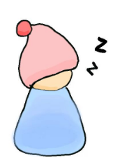
Story and Setting
Exploring the Game's Narrative and Environment
Fragmented Childhood Memories
Background Design Elements
The game's story is inspired by fragmented memories of childhood, creating an intriguing narrative.
Utilizes a combination of base imagery and interactive modules for an immersive setting.
Diverse Scenarios
Artistic Style
Cozy Desk, Mechanical Heart, Whimsical Forest, mysterious encounters.
Example~

Slide 5
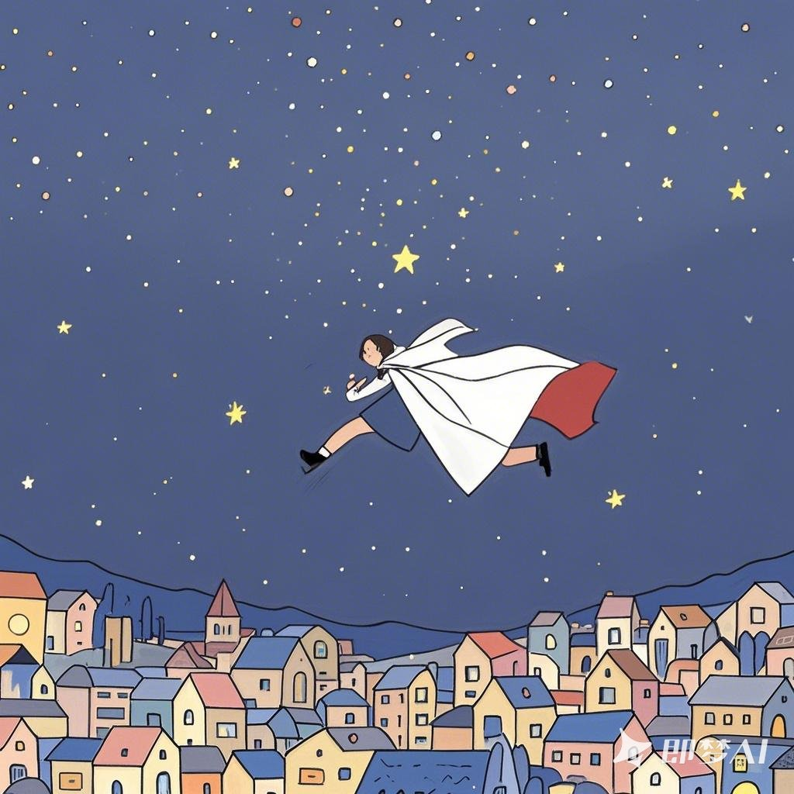
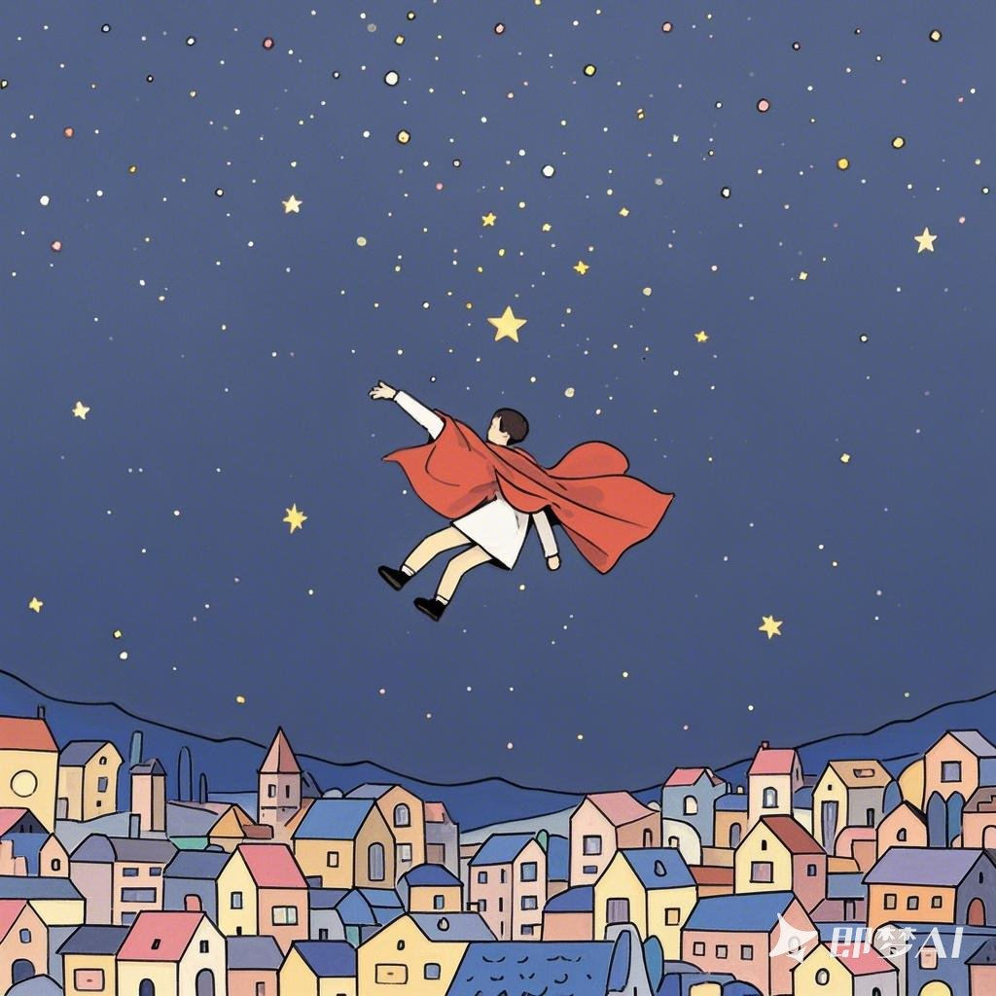
We hope to focus on resonance with players

Slide 6
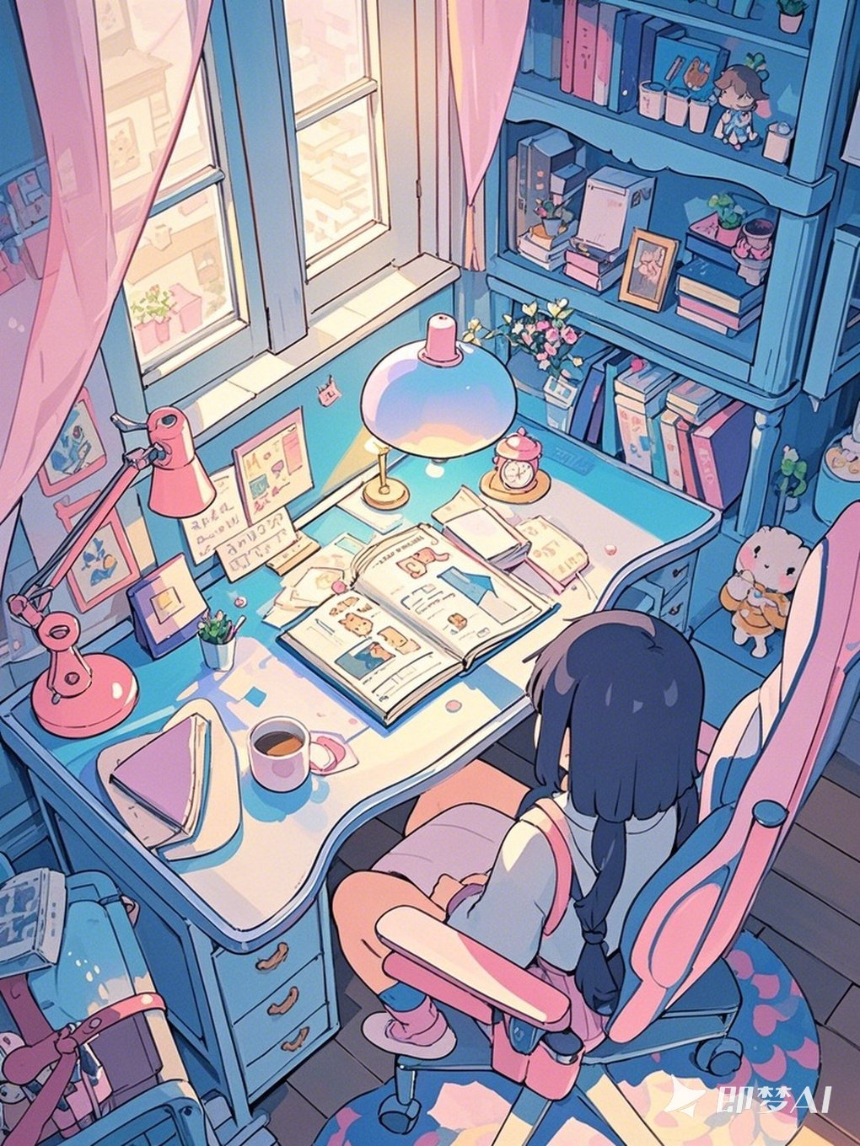
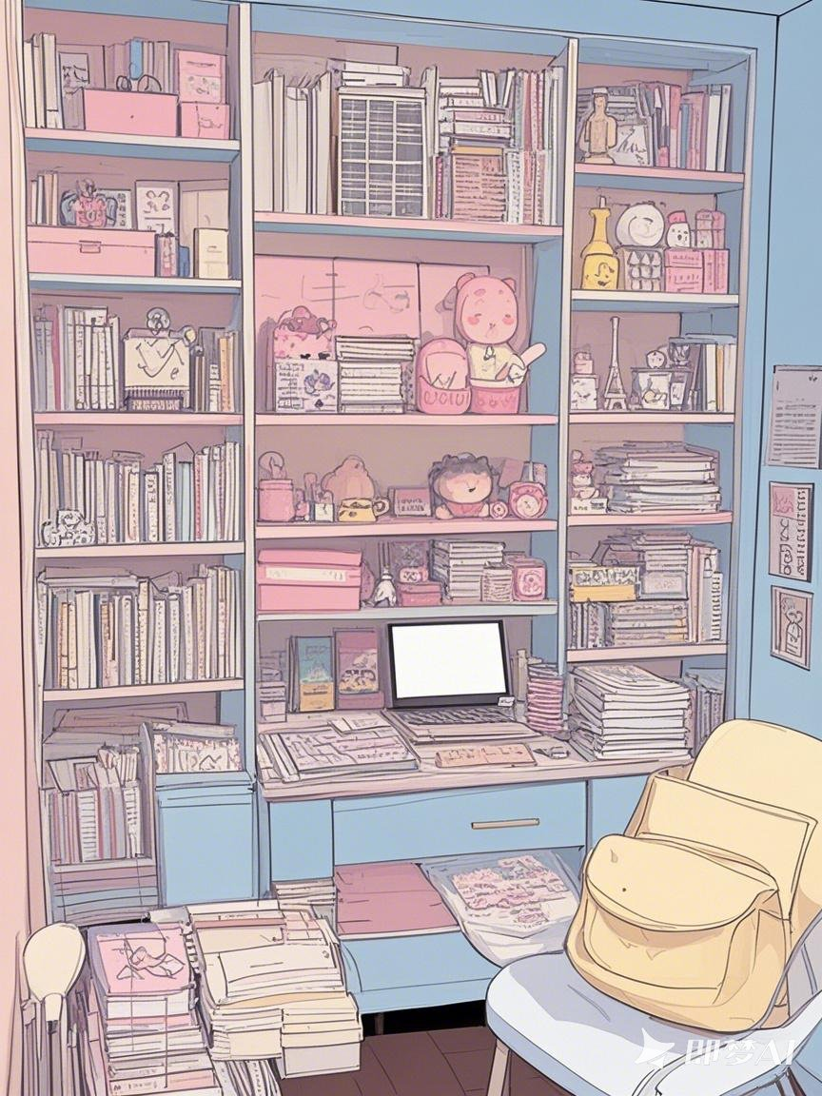
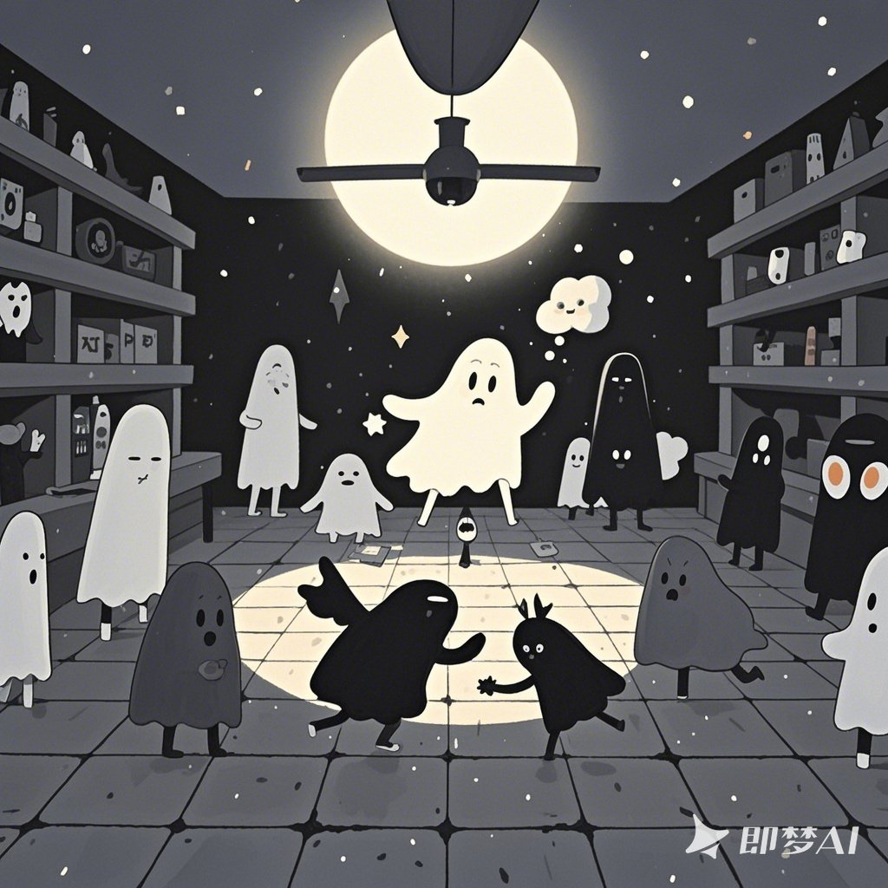
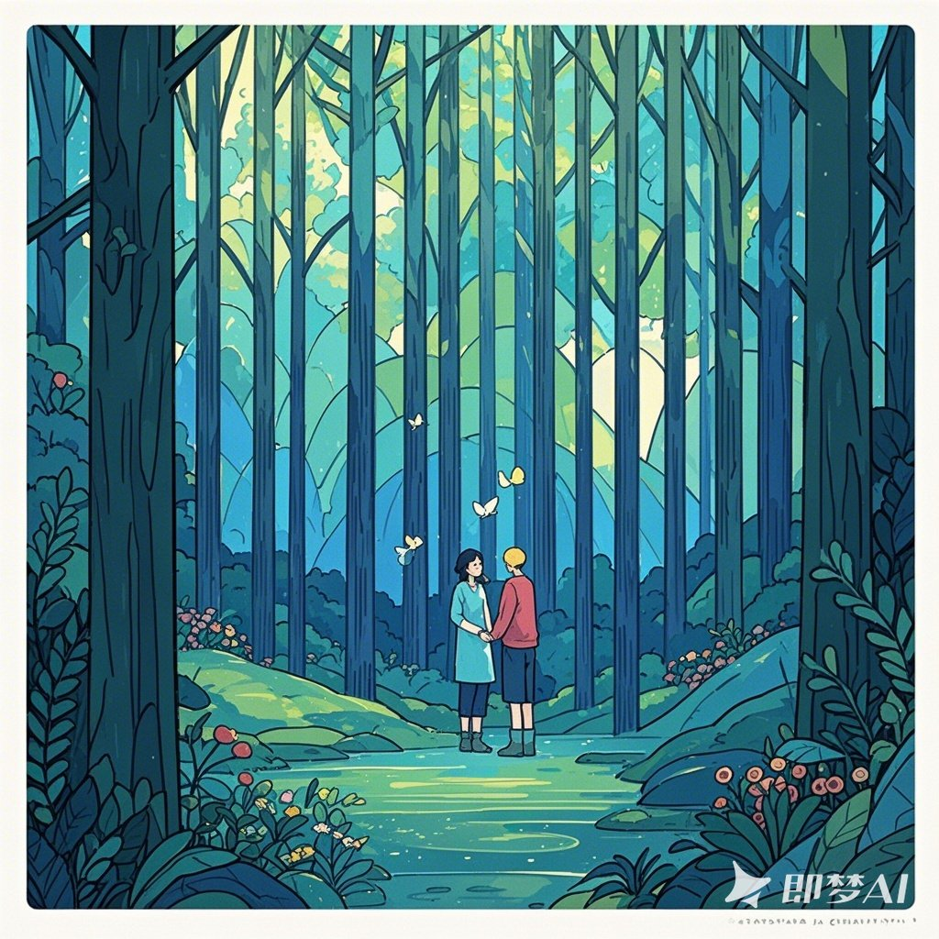
Artistic Style

Slide 7
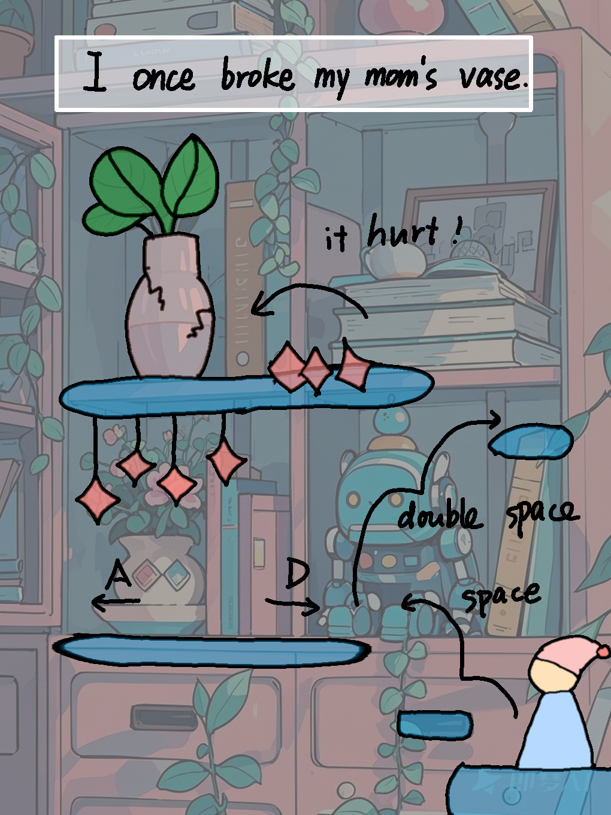
overview

Slide 8
Level Format
Insights into Game Level Creation

Slide 9
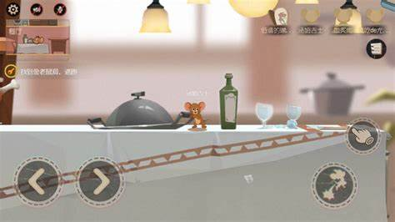
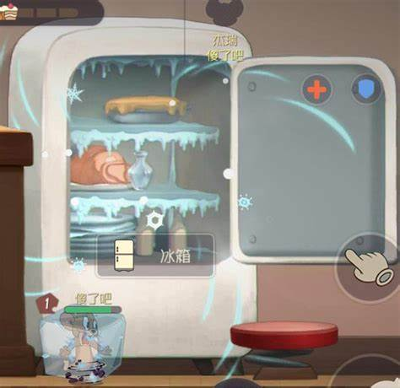
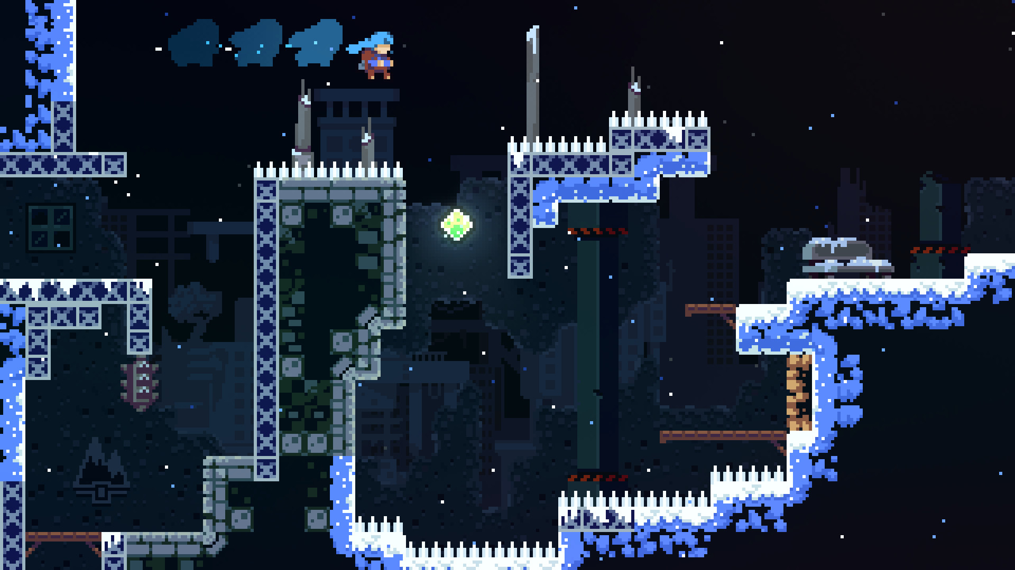

Slide 10
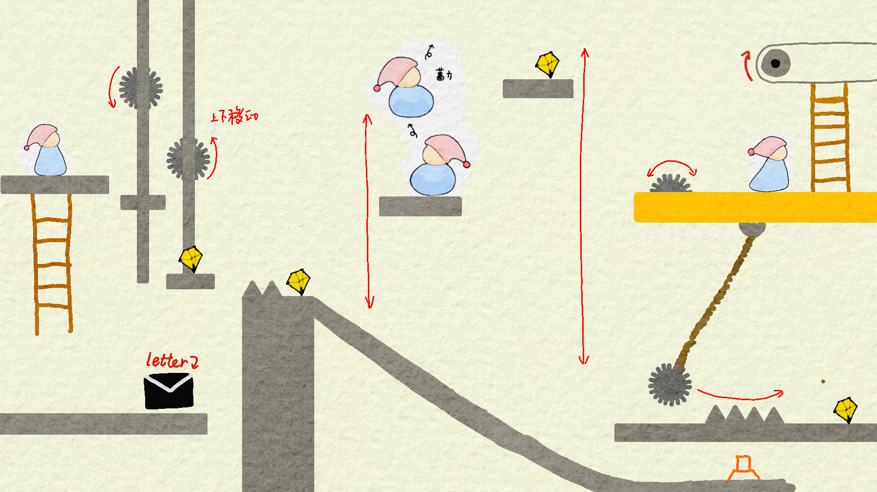
Example Level: Mechanical Castle

Slide 11
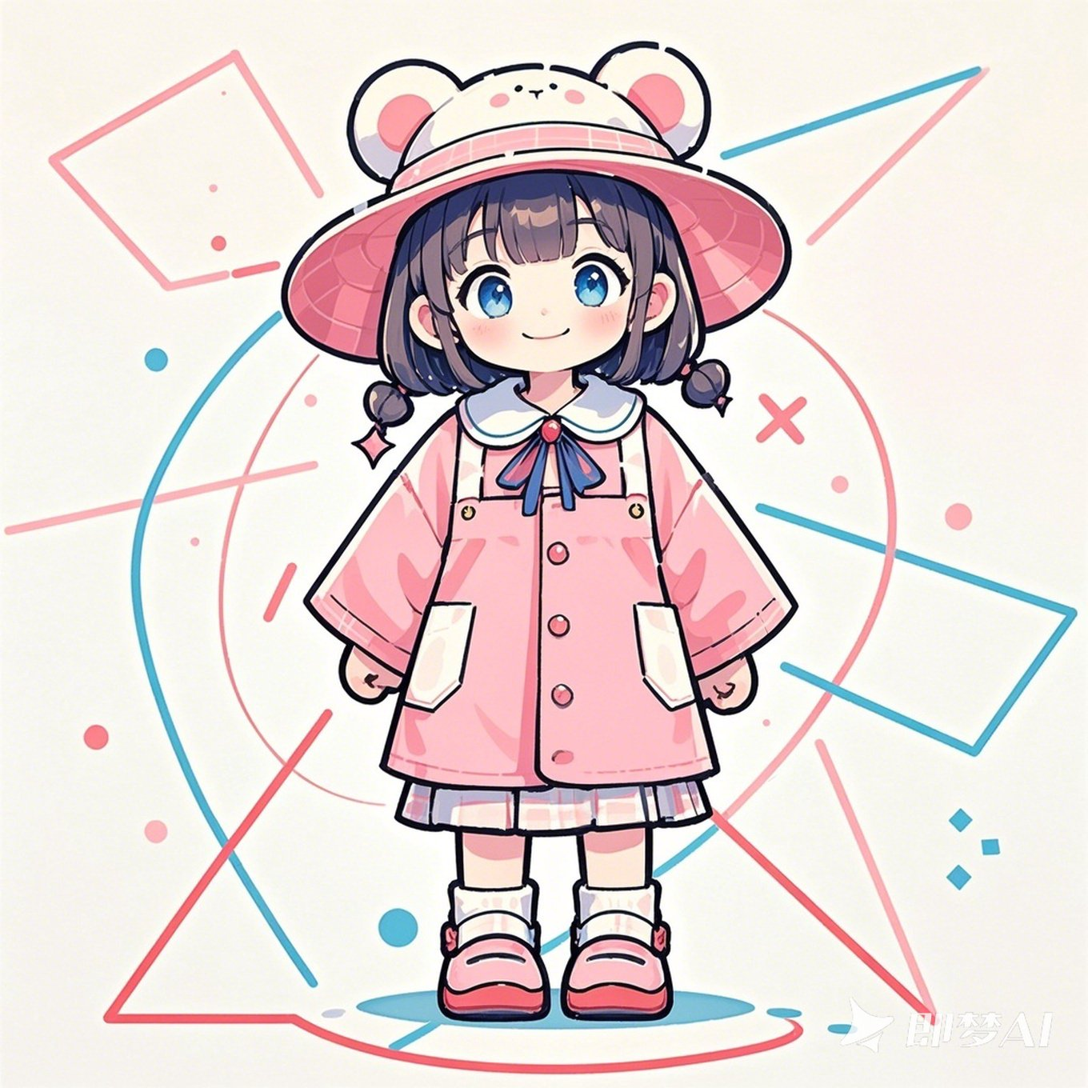
Talk with different NPC Unlock memory fragments
During the clearance process, fragments of childhood will be interspersed
I want to give you a birthday gift
Copy your homework!
Why leave me?
Why leave me?

Slide 12
Hero Moves
Understanding Gameplay and Interaction

Slide 13
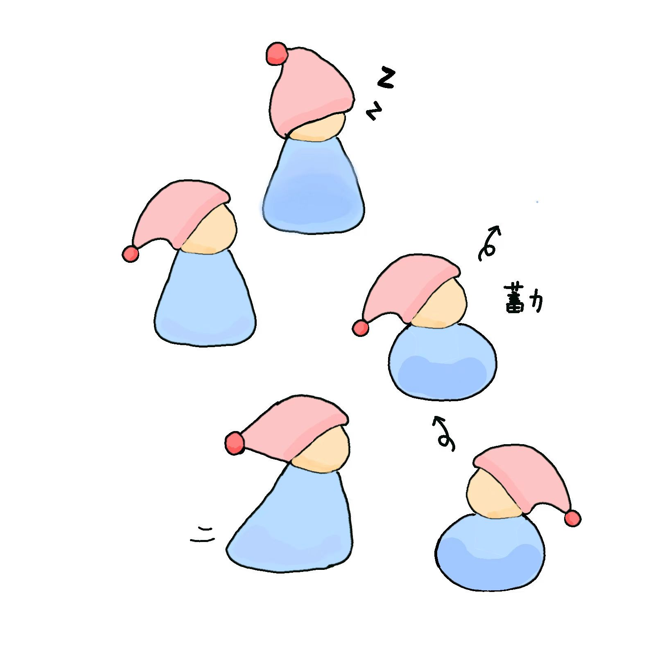
Control and Operation

Slide 14
Highlight
<Our Design>
<We want you to feel>
Delicate Scene
feel like you are EXPLORING
always feel CURIOSITY
Art Design
Complicated traps
Delicate Actions and game experience
IMMERSIVE(as exploring yourself)
RELAXED
Camera trace
Fluency of movement

Slide 15
Highlights && Challenges

Slide 16
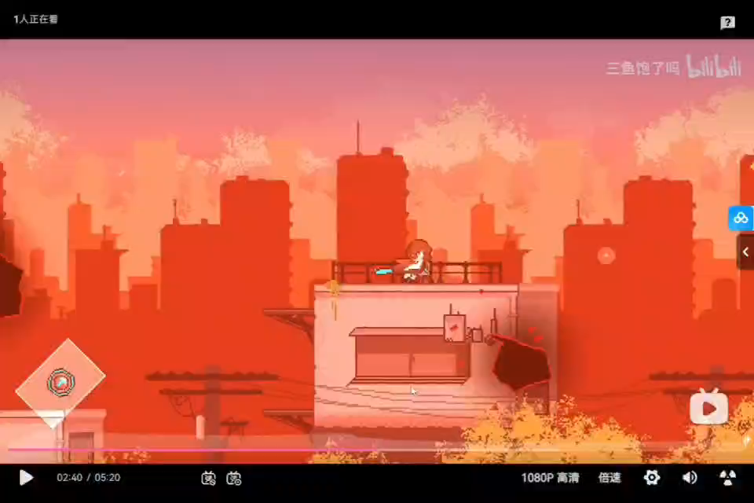

Slide 17
Highlight
<Our Design>
<We want you to feel>
Delicate Scene
feel like you are EXPLORING
always feel CURIOSITY
Art Design
Complicated traps
Delicate Actions and game experience
IMMERSIVE(as exploring yourself)
RELAXED
Camera trace
Fluency of movement

Slide 18

Challenge
>SCENE
>> PHYSICS
>>>ACTIONS
>>>> COLLIDERS

Slide 19
Let’s falling!

